Slide 1
Grief 101
Understanding Grief and How to Help
Chela Shanti R., LMFT
Sutter Care At Home Hospice
(510) 409-3039
Chela. Richheimer@sutterhealth.org
Notes:
Somatic Psychotherapist doing a power point
Grief is an emotion which like all emotions live in the body.
It is messy, non-linear, there is no beginning and end.
Basically, the opposite of a zoom power point presentation…
But here we are, Everyone here tonight has experienced loss and therefore grief.
I will focus on Bereavement since that is my field and yet I want to acknowledge other types of losses including, divorce, separation, loss of culture, language, ability. Some of you may be grieving the loss of a child who has transitioned genders.
We all want to better understand grief with the hopes that we will “do it right” maybe it won’t hurt as much or for as long, maybe we will “get over it” more quickly and get back to our “normal” lives. Maybe we can better help our loved ones in their grief, especially our children.
So, please forgive my basic power point without any fancy visuals. Hopefully you will leave tonight with a slightly better understanding of the grief process and ways we can cope and move through it. As a grief counselor I look for movement.
There will be time for questions at the end and I will do my best to address them-in the meantime, please feel free to ask for clarification and/or post questions in the chat.
Grief like most emotions is complicated and cannot be “taught” in 30 min power point. But hopefully you will leave here tonight with something helpful and be able to help me on my personal quest to normalize and de-stigmatize an often misunderstood process so that we can be
MORE KIND, COMPASSIONATE AND PATIENT WITH OURSELVES so that we may be more KIND, COMPASSIONATE an PATIENT with others.

Slide 2
Presentation Topics:
PART I: Understanding Grief
The Grief Journey
Common Responses to Loss
Intuitive and Instrumental Grievers
Worden’s Tasks of Mourning/ Teen’s Tasks of Mourning
PART II: How to Help
Companioning
What to Say and Not to Say
Possible Teen Reactions-Helpful Adult responses
Concrete Ideas for Supporting the Bereaved
What We Need During Grief

Slide 3
Part I Understanding Grief
Notes:
We live in a society which prioritizes productivity. As a bereavement counselor who works for health care, I get 2 or 3 days of bereavement. We typically don’t do a great job dealing with pain and discomfort. We use pills to take away the pain and often do not give any time and space to acknowledging the pain of loss. Therefore, many people feel like they are falling apart of going crazy. Grief is a lonely and isolating feeling. The world is going on as if nothing has happened and for you as the person who has experienced loss, nothing is the same.
Some of you in this room may be asking “well why is that?’” and to answer this question we need to look at the actual process of what grief looks like and how it can show up.

Slide 4
Jamie Anderson
“Grief, I’ve learned, is really just love. It’s all the love you want to give, but cannot. All that unspent love gathers up in the corners of your eyes, the lump in your throat, and in that hallow part of your chest.
Grief is just love with no place to go.”
Grief is also….

Slide 5
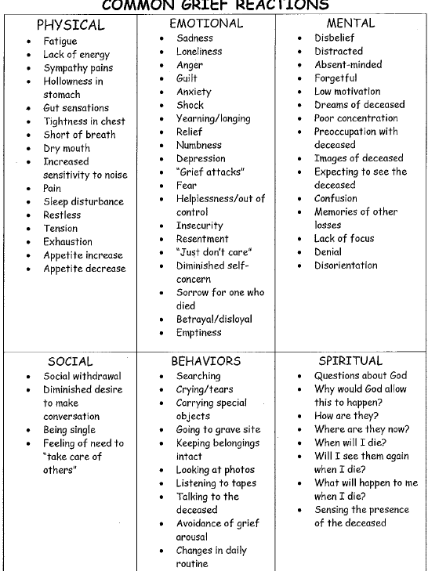

Slide 6
Teens Common Grief Reactions
Anger
Sadness
Guilt
Abandonment
Anxiety
Notes:
Anger at the person who died, anger at doctors, teachers, parents, survivors, God, the world
Teens tend to be “self centered” (developmentally appropriate) and therefore can have an exaggerated sense of their own role or impact on others.
Anxiety is often how helplessness manifests. When something really out of our control happens in our lives, we naturally may try to control what we can. Sometimes this can be used as an effective coping skill. (for example, having control over our physical space)

Slide 7
Grief Versus Mourning
Grief
Mourning
The INTERNAL state of intense feelings in response to a loss marked by intense emotional suffering.
The EXTERNAL state of expressing one’s grief. Expressing grief outwardly enables an individual to release intense feelings.
Notes:
Grief can be complicated and lifelong if not mourned.
Mourning allows the individual to begin the process of learning to cope and life with the loss. It allows the individual to begin their journey of discovering their “new normal.”

Slide 8
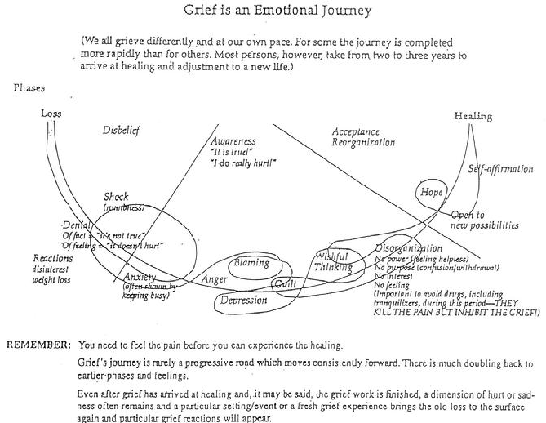
What Does Grief Look Like?
Notes:
Many of you might have heard of Kubler-Ross’s PHASES of grieving (Denial,Anger,Bargaining,Depression,Acceptance)
- misinterpreted as a linear form of grieving
But in actuality; grief really looks more like this….it goes back and forth, up and down
We start at the loss and typically for at least 6 months we live in shock with slight moments of awareness (TALK ABOUT SHOCK)
-Pick-up the phone to text
-Shock is in place to not overwhelm our system…important not to pathologize or try and move grievers quickly through this
Awareness: still have moments of shock but these moments begin to subside and as this happens the feelings of grief like (READ CHART) begin to unsurfaced
Acceptance: This does not mean we like or are even “ok” with the loss, it mainly means we are beginning to find our “new normal” or basically readjusting our lives in a new world without our person
Then we come to the place of “healing” which I prefer the word “Integration” meaning we learn how to integrate the loss into our lives so that we live a life that is more full. This is the place where my clients can see how their love and their grief are 2 different sides of the same coin. I often know my clients have moved to this place when they start expressing more hope or begin to share how they have a new appreciation for life in the face of their loss.
I would also like to share that I believe WE NEVER “GET OVER” GRIEF because we never stop missing our person

Slide 9
Styles of Grieving
Intuitive
Instrumental
Experience grief as waves of emotion.
Feel the need to express their grief and often seek support from others.
Experience grief as cognitive or physical symptoms.
Typically they will cognitively process their grief and/or immerse themselves in activities.
Taken from Men Don’t Cry…Women Do: Transcending Gender Stereotypes of Grief Martin & Doka, 2000, p. 5
Notes:
Having an understanding for the way someone grieves be helpful. There is no right or wrong way to grieve. What can be harmful (and what often impacts relationships negatively is judgment about the way someone is mourning.
When one has an understanding for their grief style they will then have an easier time seeking out what is helpful. For the intuitive it might be a support group while for the instrumental it might be going back to work.

Slide 10
Worden’s Tasks of Mourning
Task 1: To accept the reality of the loss
Task 2: To identify and express the feelings of grief
Task 3: To adjust to the loss
Task 4: To reinvest in life
Notes:
Task 1: This task is very difficult to come to terms with. The head and the heart are on their own, usually very different timeline and it is usually a long process for the heart to catch up.
Often I hear “I know in my head that they are gone but I still can’t help feelings like they are going to walk through the door” or “it doesn’t feel real”. As time passes this gets replaced with “I know they are not coming back” and getting used to the feeling of not having them in our lives
Task 2: Often I share with clients “We gotta feel it to heal it.” The only way is through. Importance of “making space” for all the emotions, experiences and waves that accompany the grief.
-This is the time to counterintuitely move towards grief/pain rather than away.
Task 3: Adjusting to the loss does not mean “getting over the grief” but rather as one client so eloquently stated it’s learning how to endure the pain.
-Again, we NEVER get over grief because we never stop missing our person; we just learn how to live without them being physically present
Task 4: happens when the client is able to embark on their new life while simultaneously having an enduring connection with the deceased. I know my clients are at this stage when they can reflect on their grief and share how this experience has shaped who they are. When they are able to remember their loved one with more love than pain.

Slide 11
Teens Task of Mourning
Accept the Reality of the loss
Experience the pain of the Grief
Adjust to an environment in which the person or experience is missing
Continuing Bonds-Figuring out how to find a new relationship with deceased.
Withdraw emotional energy from the loss and put it into a new relationship with life.
Notes:
There may be some denial. Teen’s tend to “back-burner” grief. It takes time to integrate loss, especially if it is traumatic. There may be some disassociation. Teens need things to be concrete.
They may engage in magical thinking. They might think they see them in a crowd or hear their voice.
Teens often feel invincible and when they confront the death of someone close, this belief is shattered. Teens may fight their vulnerability because it may cause them to feel more dependent on family and they need to have control. They are often moving towards independence and away from family, support.
This is the time when strong feelings surface. Their world has been turned upside down. They may have conflicting memories or feelings.
Teens may use self-mutilation to numb, or feel more deeply or “control” the pain they are experiencing.
Teens experience secondary loss. Not having the person at a sports game or party.
Loss brings up previous loss
We grieve not only what we have lost but what we will not get.
The healing begins when they reinvest in their lives and can see the “good parts”. Focusing on what we have vs. what we have lost.

Slide 12
Grief Versus Depression
Normal Grief
Clinical Depression
Responds to comfort and support
Often openly angry
Relates depressed feelings to the loss
Can still experience moments or at least see the possibility for enjoyment in life
May have some physical complaints
Expresses guilt over some specific aspect of the death
Temporary impact on self-esteem
Does not accept support
Irritable but does not express anger
Does not relate depressed feelings to a particular event
Projects an overall sense of hopelessness and chronic emptiness
Has chronic physical complaints
Has generalized feelings of guilt
Loss of self-esteem is of greater duration
Wolfelt A.D. (1988) Death and Grief: A guide for Clergy, Accelerated Development
Notes:
Often what I hear from folks is the fear that they are depressed. Grief is NOT depression but it often presents in many of the same ways. Here is a chart on the differences between grief and depression…
“Grief is neither a problem to be solved nor a difficulty to be overcome. It is a sacred expression of love-a sacred sorrow.” – Dr. Gerald May

Slide 13
Grief and Attachment
Our attachment figure dies
we become deprived of our fundamental attachment
we experience loss and fear of the unknown
our assumptions about safety, people in our lives and routines are completely altered
this leads to insecurity, panic and feelings of powerlessness
which results in a paradoxical felt need for others while also wanting to remain alone
Notes:
In his book A Grief Observed C.S. Lewis describes this as…
“There is a sort of invisible blanket between the world and me. I find it hard to take in what anyone says. Or perhaps, hard to want to take it in. It is so uninteresting. Yet I want the others to be about me. I dread the moments when the house is empty. If only they would talk to one another and not to me.”
For the griever this can feel overwhelmingly confusing. While for the ones supporting the griever, they too can feel confused by this.
Recommended; parallel play ie. Watching tv together, in company of others but not needing to engage which takes energy.

Slide 14
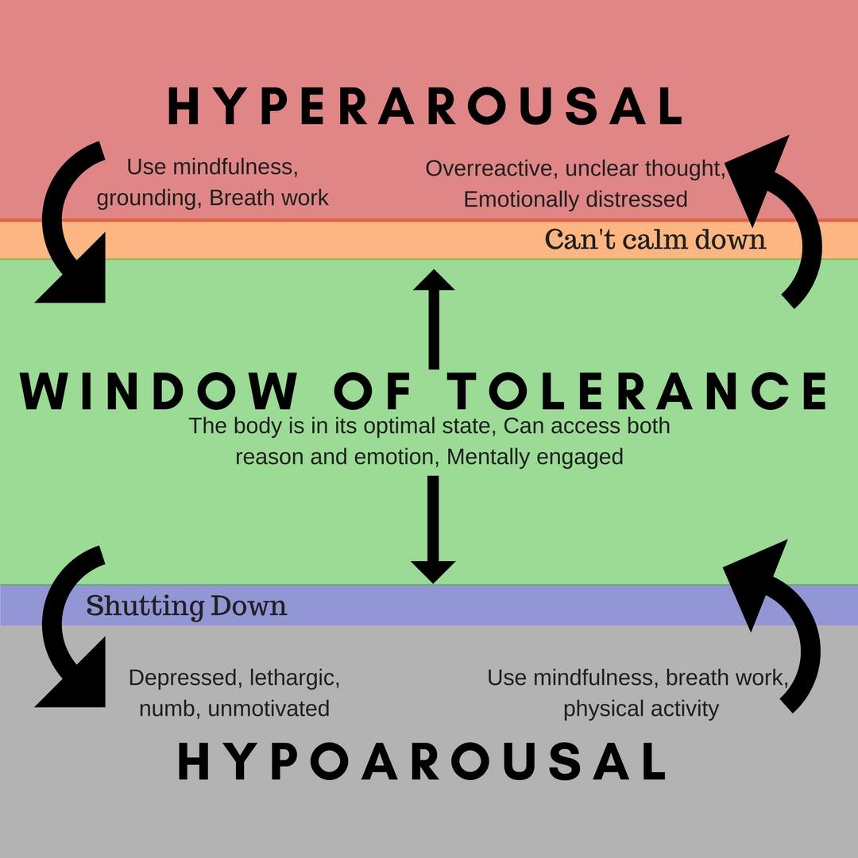
Grief and Trauma

Slide 15
Part II How to Help
Notes:
So how do we help people with these tasks

Slide 16
What to say/not to say
What to say:
I am here and available for you. The rest of us will take care of you.
Grief is a process, not an event-that is why there is need for continued support.
Grief doesn’t get smaller, life around it gets bigger
Things might get harder, then easier, then harder again because grief is not linear
It’s like carrying a heavy backpack which gets lighter over time.
Its hard work, that is why you are exhausted and why self-care is so important
Grief is like loosing layers of skin-you can feel things more deeply
you’re right, this is unfair!
It is all right to laugh and feel joy.
What NOT to say:
Nothing
I understand/I know how you feel
Any thing that starts with “at least…”
They are in a better place
God only gives you what you can handle
It’s for the best
Let me know if there is anything I can do
You’re so strong
Try to put it behind you
Notes:
Model mourning. “I am sad/angry…” and I can still take care of you.
Feeling good doesn’t mean something bad didn’t happen. We are capable of feeling good and bad at the same time!

Slide 17
Companioning
“Companioning is about being totally present to the mourner, even being a temporary guardian of her soul.” “Introduction To Companioning the Bereaved” by Alan D. Wolfelt
“you must create a “safe place” for people to embrace their feelings of profound loss. This safe place is a cleaned-out, compassionate heart. It is the open heart that allows you to be truly present to another human being’s intimate pain.” “Introduction To Companioning the Bereaved” by Alan D. Wolfelt
Meet the griever where they are at.
Notes:
A concept first introduced by author, educator and grief counselor Dr. Alan Wolfelt,
At the heart of companioning is making space to bear witness to another’s deepest, most profound pain and not trying to change it or make it go away…THERE IS NOTHING WE CAN DO TO TAKE AWAY ANYONE’S GRIEF not even our own. It is not our job to fix in grief.

Slide 18
Possible Grief Reactions and Helpful Adult Response
Ages 13-Adult
Helpful Adult Responses
Build Self-esteem
Share grief, respect privacy
Listen, avoid power-struggles
Attentive, support searching
Short-term goals
Acknowledge
If prolonged, seek help
Acceptance and assurance
Redefine expectations
Conformity to peers
Non-communicative
Conflict with adults, aggressive
Questioning life’s meaning
Insecurity about future
Criticize or idealize deceased
Sleep disturbances
Regressive behaviors
Academic difficulties

Slide 19
What we need during Grief
TIME
REST, RELAXATION
EXERCISE
NOURISHMENT
DIVERSION
THINGS TO LOOK FORWARD TO
SECURITY
SMALL PLEASURES
PERMISSION TO “BACKSLIDE”
TO BE KIND, GENTLE WITH OURSELVES
SUPPORT
WAYS TO EXTERNALIZE FEELINGS IE. “LETTING IT OUT”
Notes:
Why Drugs and Alcohol are not helpful
“We gotta feel it to heal it”! We need to move through the feelings and emotions which accompany grief. We cannot “get over” it. There are no short cuts.
Unprocessed grief can lead to depression and physical symptoms such as headaches, stomach aches, pain in the body.
Grief is an emotion. We hold emotions in our bodies.

Slide 20
What helps
Making Art
Movement
Nourishment
Externalizing Feelings
Creating safety
Support
Ritual
Helping others
Gratitude practice
Notes:
collages, alters, memorializing with photos
Walking, exercise of all kinds
Therapy is not the only thing which is therapeutic. What things that you put in your body nourish you? Who nourishes you? What places/environments nourish you? What activities nourish you?
Writing, Journaling, Crying-(benefit of emotional tears) screaming, tearing/breaking things, talking to those you trust. Seeking professional help. Prompts for getting them to talk
Focusing on what we have and not what we have lost- NOT “we are lucky because…” sometimes “I am grateful for…” is too much.
BEST PART OF DAY gratitude practice.

Slide 21
Getting your teen to express
What makes you the saddest? Angriest? Most confused? Most worried?
If you could talk to them or ask them something , what would it be?
Since their death…If you could change…
Your worst/best memory of them?
When you are alone? When you try to go to sleep? When you are at school?
What is the hardest part?
What do you do to feel better?

Slide 22
Helping Yourself as a Caregiver What is self care? Meeting your self where you are at.
Recognizing Your Needs:
Develop Tools for Coping:
When do you need support
What kind of support do you need
What kind of boundaries do you need
Recognizing and respecting your boundaries
Supportive relationships/community
Interest/Activities/Hobbies
Self Care
Notes:
Definition of Self Care as Meeting yourself where you are at. This might mean massages/mani pedis and bubble baths. This might mean loud aggressive music while boxing. This might mean staying under the covers. -
Not a SELFISH ACT, rather a vital RADICAL act

Slide 23
“You see, love and grief are two sides of the same precious coin. One does not—and cannot—exist without the other. They are the yin and yang of our lives… If we allow ourselves the grace that comes with love, we must allow ourselves the grace that is required to mourn.” – Alan D. Wolfelt, Ph. D.
Notes:
What I want y’all to take away from this presentation.
Importance of recognizing and normalizing grief PROCESS.
Grief is not an event. It is a process. We need to feel it to heal it.
We all grieve and cope differently.
That helping a loved one in grief is meeting them where they are at. Helping them feel seen and heard.
Helping yourself in grief is meeting yourself where you are at. Practice kindness, patience and self compassion with yourself. THIS IS A RADICAL ACT.

Slide 24
Bereavement Department Sutter Care At Home (510) 263-0903
Notes:
Resources for Teens
BHS Health Center
Crisis Support Services of Alameda County
Circle of Care
Sutter Care At Home Hospice
Pathways Hospice
Dougy Center (on line resources)

